Slide 1
Home Inspections
Demystifying Home Inspections for
Landlords

Slide 2
Home Inspections
When a participant is approved, and receives a Housing Choice Voucher, one of the requirements is that the unit passes a Housing Quality Standard (HQS) inspection before the rental assistance will begin.
The HQS inspection will also be conducted on an Annual basis as long as the tenant is receiving rental assistance for that unit.
These inspections are conducted by Fresno Housing’s certified HQS inspectors.

Slide 3
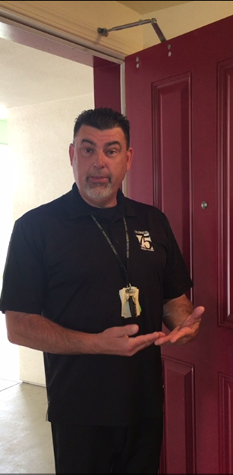
Upon Arrival
The inspector will verify the following information:
The name of the person at the door, and if they are over the age of 18. (I.D. may be required)
The residents current phone number, and email address, if applicable.
If they have any pest control issues that may prohibit us from entering (e.g., bed bugs).
Who is responsible for the payment of the water, sewer, garbage, and utilities.
Who supplied the appliances.

Slide 4
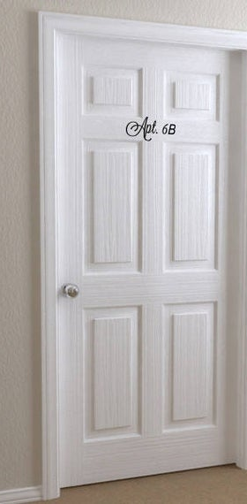
Front Door
Door must open/close properly, have secure hinges, a smooth and finished frame, free of cutting hazards.
Locks:
  Must lock and unlock without restrictions. A single keyed deadbolt is preferred. The tenant must be able to exit the unit without the use of a key.
Light through the door frame:
  This would be an indicator that the door may not have proper weather-stripping, or secure hinges, which would be noted by the Inspector as a finding.

Slide 5
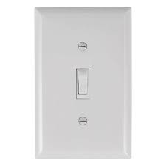
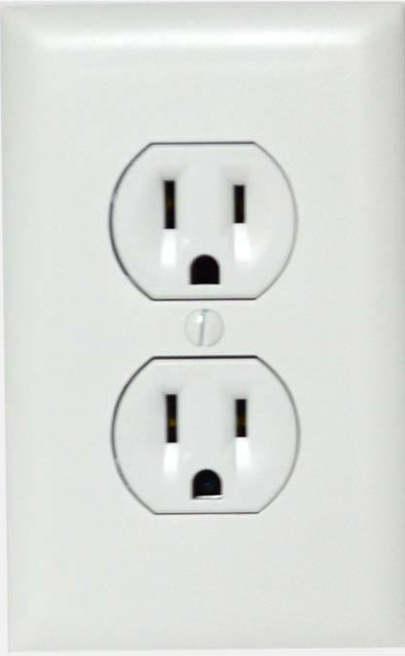
Lights and Electrical Outlets
Lights:
ALL light switches should work properly (not loose, or damaged, creating a hazard).
ALL light fixtures must have bulbs, and be in working order (even if they are located in closets). No exposed sockets.
ALL switches need to have secure and properly installed covers.
Outlets:
ALL outlets throughout the unit must be in working condition.
Ensure outlets are properly grounded (if it is a 3 prong outlets only).
ALL outlets need to have secure and properly installed covers.
Inspector will view the outlet for obvious signs of cracking, or burning.
If the outlet is a Ground Fault Interrupter (GFI) outlet, the outlet must work properly and should be able to be set/reset manually.
Note: If home is occupied, tenants may be asked to move light furniture to check the outlets.

Slide 6
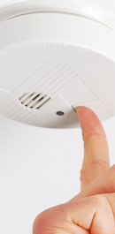
Smoke Detectors
ALL smoke detectors will be tested.
Smoke detectors and carbon monoxide detectors must be properly installed in compliance with the local building codes, and/or as recommended by the manufacturer.
The smoke alarms will be activated:
  In new construction, all the alarms should sound off at the same time.
  In older construction, the alarms will sound off individually.
Note: ALL smoke alarms that are installed in the home MUST be in working order.

Slide 7
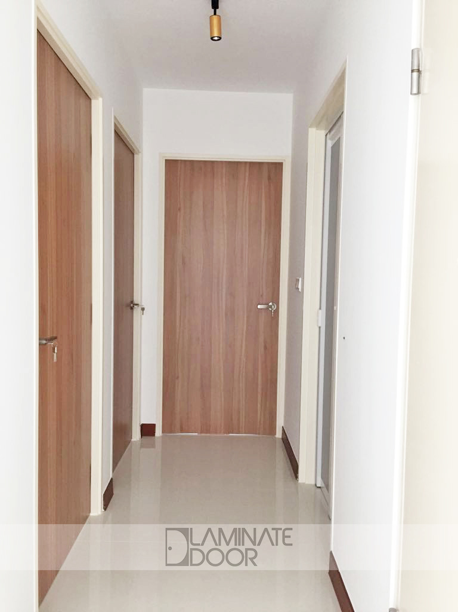
Interior Doors and Closets
Doors:
  Ensure ALL interior doors open and close as designed.
  Doors should not have loose/missing hinges, holes, or graffiti
Closets:
  Ensure there are no flammable materials or hazardous substances stored inside the unit.
  Inspected to ensure there is not a lot of clutter or debris, which may encourage insect/rodent infestation and/or provide evidence of housekeeping deficiencies.
  Ensure no water staining or mold is found in the closets (e.g. shared wall with bathroom/kitchen/laundry room, which may indicate a water leak in another room, or the ceiling).
Note: Closet doors are not a requirement to meet HQS. If closet doors are present in the unit, they MUST be installed and working properly.

Slide 8
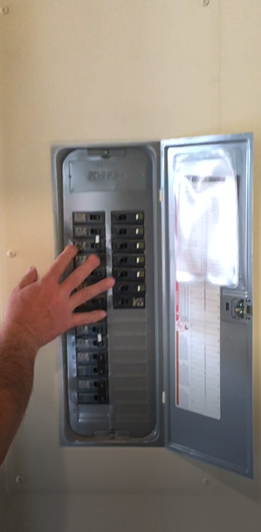
Electrical Panels
Panels should have properly installed door/cover.
Panel should not have holes or empty slots. Slot may be covered with an electrical blank, if necessary.
Note: Older homes that only have two hole pronged outlets throughout the home, NEED to have a test button in the electrical panel to indicate a ground.

Slide 9
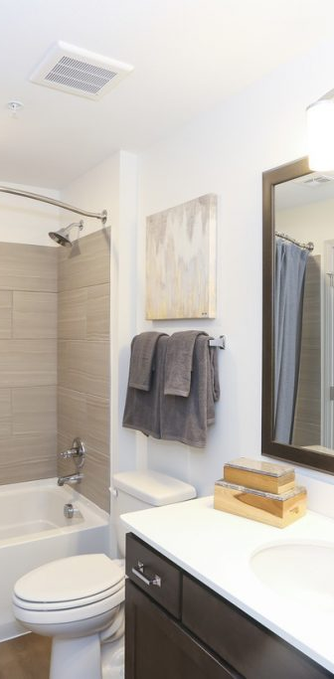
Bathrooms
Water faucets/knobs need to work in both cold and hot settings:
  Faucets must not have water dripping or leaking when turned off properly.
Cabinets are opened to ensure:
  A properly installed P-Trap is present.
  There are no leaking drain pipes, or damage from prior leaks.
  Cabinet doors have secure hinges, and are opening/closing properly.
Toilets need to be flushing properly, secured to the flooring, and no signs of leaking.
Showers need to be in working order including the following:
  Shower diverter (excessive water from the bottom faucet when shower head is engaged).
  Shower heads should work properly and not have leaks or spray at fittings.
  Shower walls should not have holes, cracks, missing tiles or caulking, which could allow water infiltration in to wall.
Ventilation fans are required only if there is no window to the exterior.
Note: All items installed in the bathroom must be in working order and free of damage. Sinks/vanity secured to wall, if applicable. No chipping or rust in sink, fixtures, fans, medicine cabinet.

Slide 10
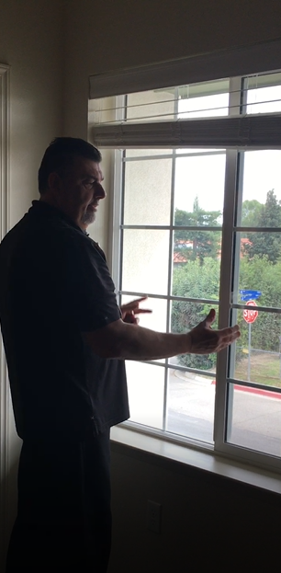
Windows
Windows should open, close and lock for tenant safety and security (either with thumb lock or a working lock). If window opens upwards, it must be able to stay open freely.
Windows need to be weather tight and free of air/element infiltration.
Windows cannot be broken or cracked.
Note: Window coverings and screens are not required to meet HQS.

Slide 11
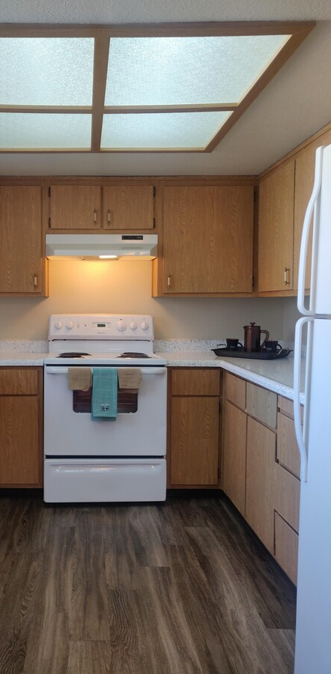
Kitchens
Refrigerators:
Interior will be inspected to ensure the refrigerator is working, and cooling at the proper temperature.
Doors will be inspected to ensure the seals are not loose, torn or in need of repair/replacement.
Cabinets:
Doors should have secure hinges, and are opening/closing properly.
Range hoods:
Vent motor must be in working order, no loose or exposed wires, and with a clean vent screen.
Range hood cannot have any chipping, peeling, grease or rust on the underside, or the top.
Stove and Oven:
Stove and oven must be clean, and in good working condition
Oven door seals should be secured, if applicable
Sinks and Faucets:
There is a properly installed P-Trap. There are no leaking drain pipes, or water leaks from garbage disposal, if present. The sheeting under the sink must be clean, painted, and with no signs of water damage.
Faucets must be secure and functioning at cold and hot water settings. Faucet does not leak when knobs are properly closed.
NOTE: Any other owner provided amenities e.g. garbage disposal, dishwasher, or microwave MUST be in proper working condition.

Slide 12
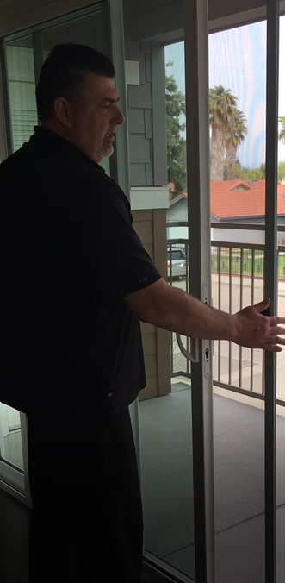
Sliding Glass Doors
Glass doors cannot have any signs of cracking or breakage.
Doors must be able to open, close and lock properly.
Door tracks must be clean, free of debris, and with no sharp edges.
Screens are not required to meet HQS.

Slide 13
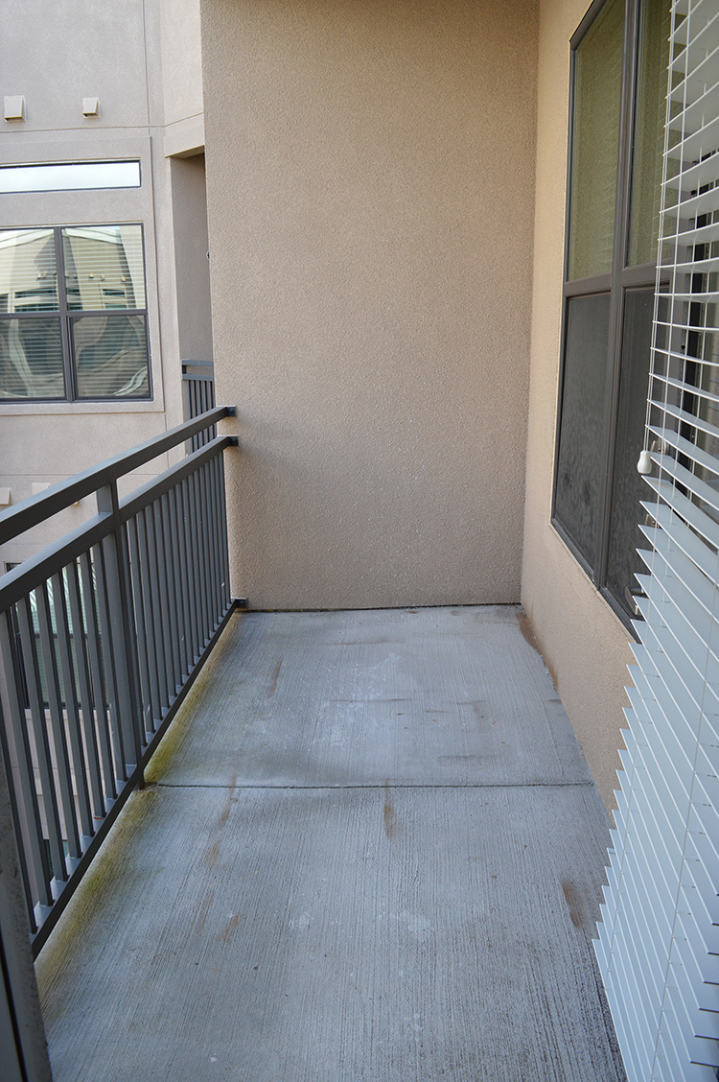
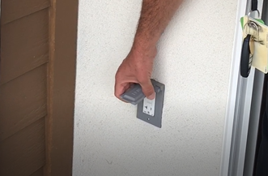
Outdoor Area and Closets
Area must be maintained and in “move-in ready” condition (clean and clutter free).
Must not have hazardous materials stored in these areas, and specifically not in outdoor or water heater closets.
ALL exterior outlets MUST have the proper enclosed cover, be working, and properly grounded.

Slide 14
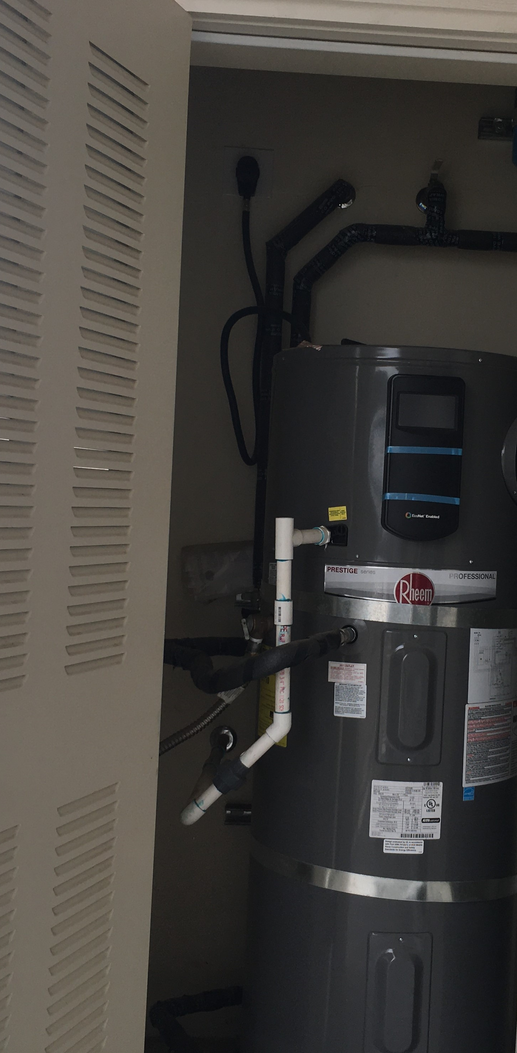
Water Heaters
The water heater closet must be properly vented and free of chipping, peeling paint, and debris, leaves, etc.
Water heater closet must not have flammable materials stored inside.
Water heater and connectors cannot have any signs of corrosion, leaks, or missing parts.
If water heater is located inside the unit with walls shared with the exterior, the discharge line must point downward. The discharge line cannot have an upward pitch, kinking, or flexing pipe, and must be made of material specifically made for water heaters. This discharge line can be made of CVPC, copper, or galvanized pipe, but cannot be capped, or have the ability to be capped (no threads on the end of the pipe).
The water heater must have earthquake straps properly installed
For gas water heaters, the gas lines must have shut off valves.
If the water heater is in a garage, it must be installed at a minimum height of 18 inches off the ground. Items cannot be stored or installed near the water heater, ensuring there is a 3 foot clearance around it at all times.

Slide 15
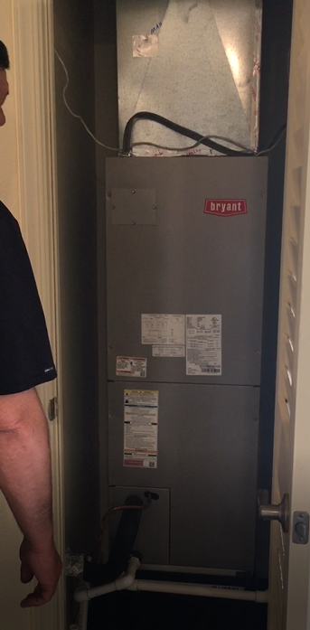
Furnace
If the property has a furnace, it must be properly connected and in good working order.
The heater closet cannot not have any materials, flammable or otherwise, stored inside.
Electrical outlets in the closet must have cover plates, be working and properly grounded.
If the furnace is gas, ensure the gas lines have a proper shut off valve.
Surfaces in the furnace closet must not have evidence of water leaking and/or damage due to prior leak.
If the furnace is in an interior closet, the walls and ceiling inside the closet must be in a finished state and free of holes.

Slide 16
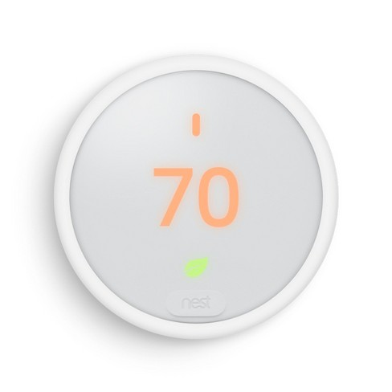
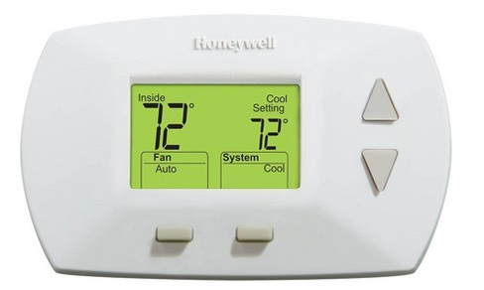
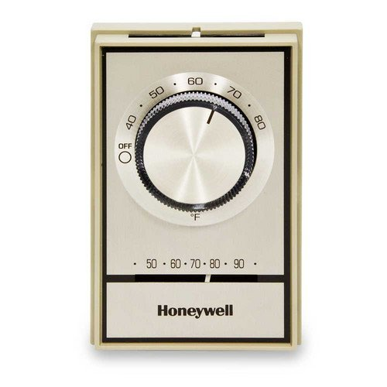
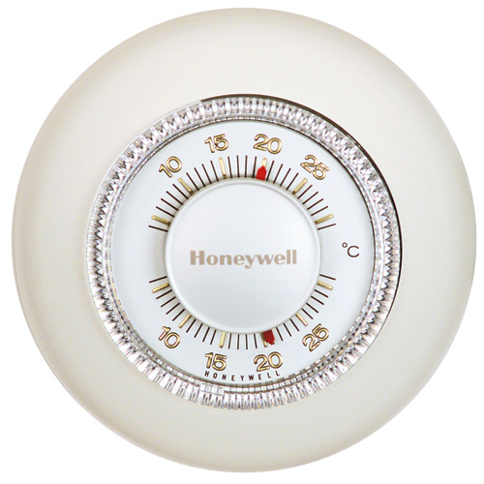
Cooling System
Air conditioning:
The air conditioning unit must be in proper working order.
The thermostat must be properly installed, covered, and in proper working order.
If the cooling system is a wall or window unit, it must be installed in an area sufficient to cool all rooms, and, have the proper BTU’s based on the square footage of the unit.
Swamp cooler:
Must be working properly, and have a drainage line properly installed and not in an area that would create a hazard

Slide 17
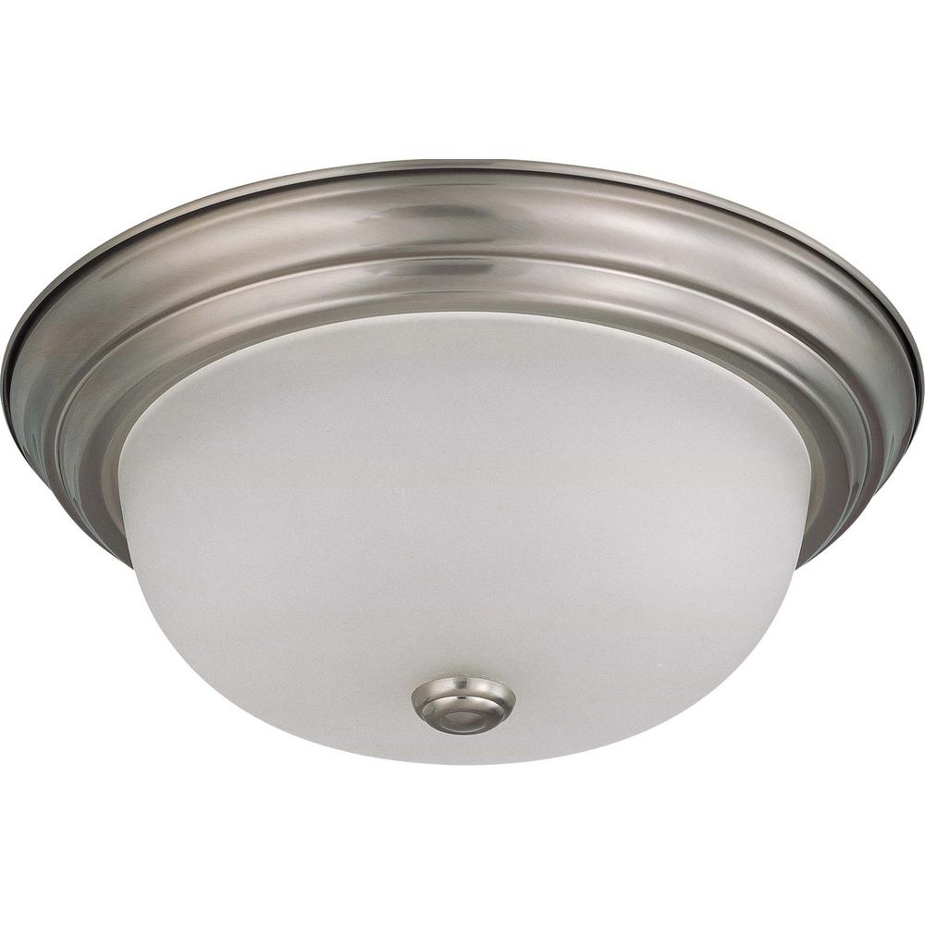
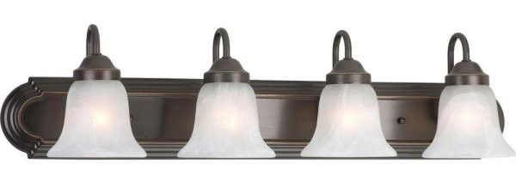
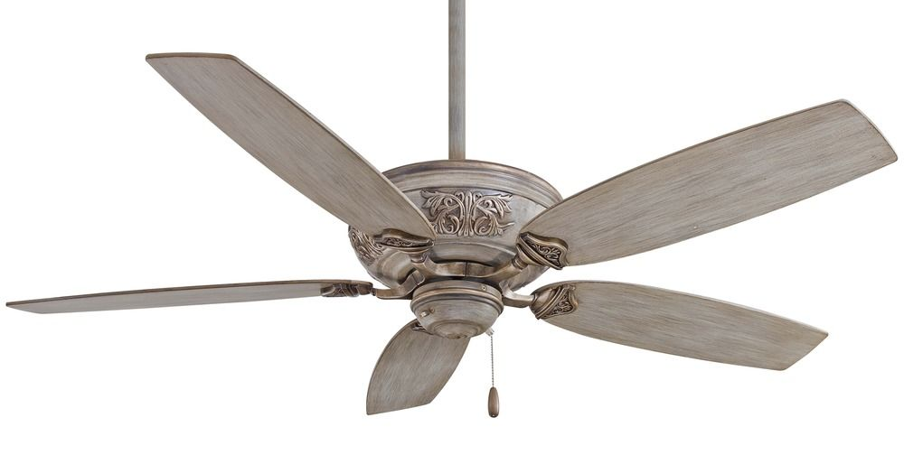
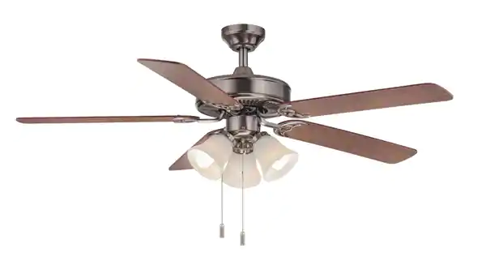
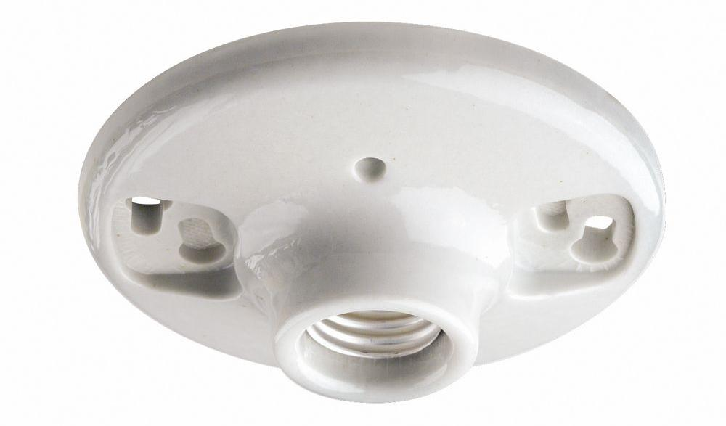
Fixtures and Fans
ALL affixed light fixtures must be in proper working order, and have covers without cracks or chips. Bulbs must be present, eliminating exposed sockets.
ALL affixed ceiling fans must be in proper working order. Fan must be securely installed, attached to the ceiling, and not shaking or swaying. If a light kit is included, bulbs must be present, eliminating exposed sockets.
NOTE: Open sockets are never allowed (every socket must have a light bulb).

Slide 18
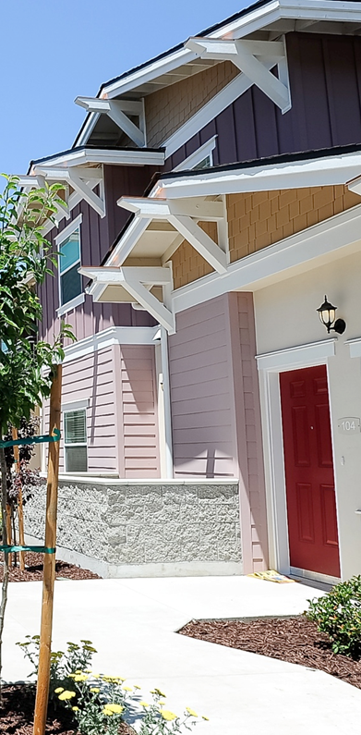
Outdoors
Exterior surfaces, over hangs, doors, fences, siding, stucco, and fascia boards are inspected for signs of deterioration and chipping paint.
Paths/walkways leading to, or around the unit, must be level and free of tripping hazards.
Property address and/or apartment numbers must be clear, visible, and in plain sight from the street.
Trees, branches, cannot be encroaching on to the unit, blocking windows, or touching the roof.

Slide 19
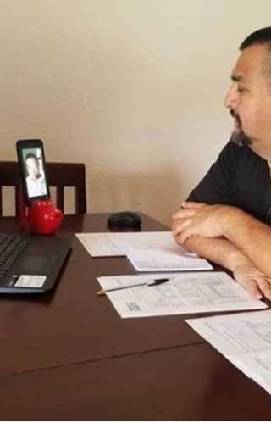
Inspectors
Our certified HQS inspectors will ensure that there are no visible, immediate hazards to the unit.
In the event a hazard exists, they will determine whether the repair will be required by the tenant or owner. For example, If the unit is occupied, missing light bulbs are the responsibility of the tenant. Inoperable range hood motor would be owner responsibility.
The initial move-in Inspection on a vacant unit will only identify the owner as responsible for the required repairs.

Slide 20
Thank you!
If you have questions or would like additional information regarding the Inspection process, please contact us at (559) 443-8400 x 5621
hcvinspections@fresnohousing.org
Visit us at www.fresnohousing.org

